Slide 1



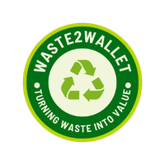




Waste2Wallet
RenewWaste: A Digital, Incentivised Recycling Platform for Urban Households and SMEs in Lagos, Nigeria
Strategic Innovation and Entrepreneurship

Slide 2



Waste2Wallet
Opening - The Pitch
Lagos produces more than 13,000-15,000 tonnes of waste per day, but there is a lack of structured and incentivised recycling.
A digital platform that provides a schedule of waste collection and rewards for recycling.
Target middle-income households and SMEs in Ikeja, Yaba, Surulere and Lekki.
Revenue is generated from subscriptions, sales of recyclable products and sustainability partnerships.
Formalised collection, real-time tracking and instant rewards, with phase release from months one to four.
Notes:
Good day. I am presenting Wate2Wallet, a digital platform solving Lagos's waste crisis. Lagos produces more than 13,000-15,000 tons of waste every day (Opanuga, 2025), and there is no incentivised and reliable mechanism for household waste to be recycled. That's why we offer airtime rewards, instant Naira payout, and a scheduled pickup. We focus on the middle class and SMEs in Ikeja, Yaba, Surulere, and Lekki, where waste collection costs exceed 5,000 naira per month. Our unique value proposition is turning waste into wallet, scheduled pickup, instant payout, and no hassle. We earn through SME subscriptions, selling recyclables, and brand partnerships. We are reliable, trackable, and pay right away, unlike informal collectors. Our milestones are MVP in month one, pilot in month two, one hundred users by month three, and full launch in month four. Each kilo recycled cleans your community and brings money to your pocket. Join us.

Slide 3
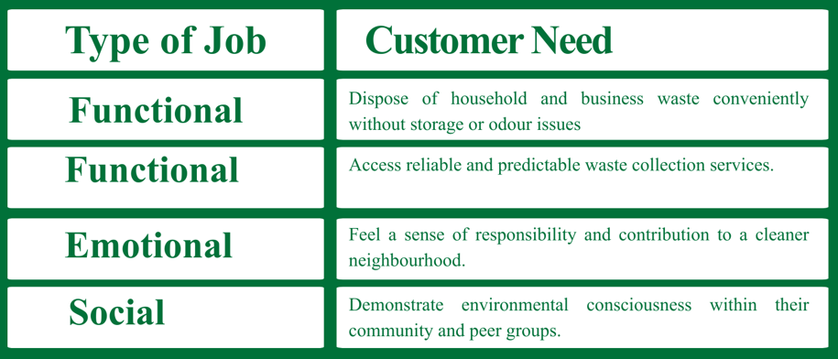
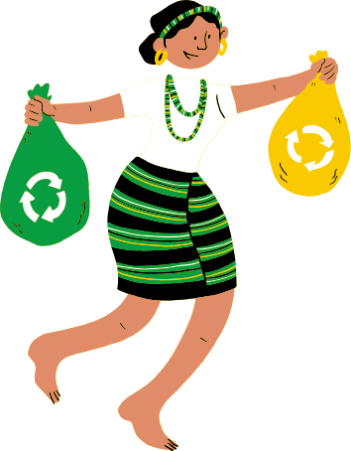


Waste2Wallet
Customer Jobs
Notes:
According to Osterwalder et al. (2014), the Value Proposition Canvas identifies three types of customer jobs: functional, emotional, and social. Waste2Wallet customers have three types of jobs. In practice, they should be able to get rid of the garbage easily without any storage or odour problems. They also require a reliable and predictable collection system, which does not currently exist. Emotionally, they want to feel a sense of responsibility and contribution to a cleaner neighbourhood. Socially, they want to show that they are environmentally aware in their community. Our platform is not only about the practical disposal issue but also covers all three dimensions.

Slide 4
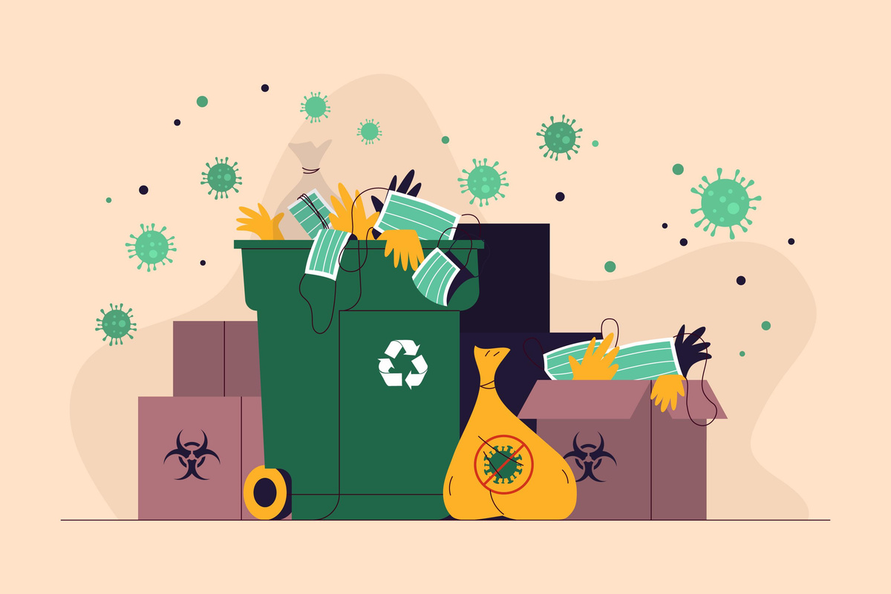


Waste2Wallet
Customer Pains
Poor waste disposal results in odor, build-up, and potential health risks
No accountability or tracking if collection fails
The potential health hazards associated with long-term waste accumulation and insect damage
No value received for separating recyclables, while paying for disposal!
Notes:
Using the Value Proposition Canvas framework (Osterwalder et al., 2014), customer pains are the frustrations and risks customers currently experience. Customer pains in Lagos are structural failures. Irregular collection is the norm, with no accountability when it fails. Customers face health risks and pay to dispose of items but don't get a monetary reward for recycling. Waste2Wallet solves these pains by offering scheduled collection, real-time tracking, and real-time payment.

Slide 5


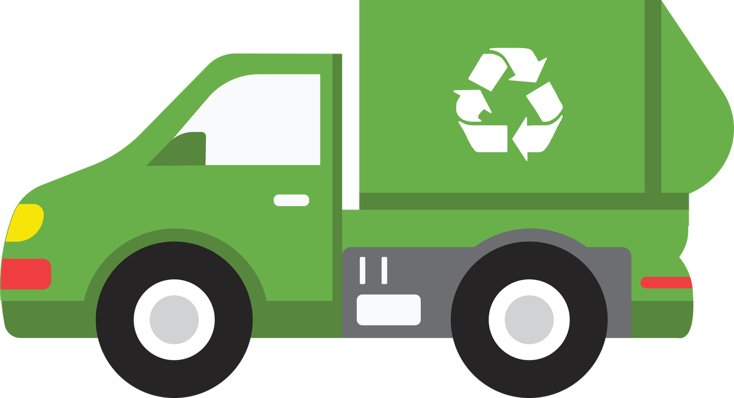








Waste2Wallet
Time saved due to reliable and scheduled pick up without repetitive follow-ups (Faiz et al., 2024)
Customer Gains
A hygienic and healthy living environment with limited waste accumulation (Schoeman and Rampedi, 2022)
Satisfaction in knowing that waste is disposed of responsibly (Roberts-Lombard, Jaiyeoba, 2025)
Rewards for recycling, conversion of waste to income (Ferronato and Torretta, 2022)
Community recognition as environmentally responsible citizens (Etim, 2024)
Notes:
Customer gains extend beyond financial incentives. According to Schoeman and Rampedi (2022), a clean living environment with reduced waste accumulation is a primary motivator. Ferronato and Torretta (2022) agree that cash incentives can convert waste to income, but only under certain market conditions. Faiz et al. (2024) found that time saved through reliable scheduled pickup is highly valued. Roberts-Lombard and Jaiyeoba (2025) prove that responsible disposal leads to peace of mind and trust. Finally, Etim (2024) shows that social recognition as environmentally conscious citizens matters in urban African communities. Waste2Wallet provides all five gains.

Slide 6


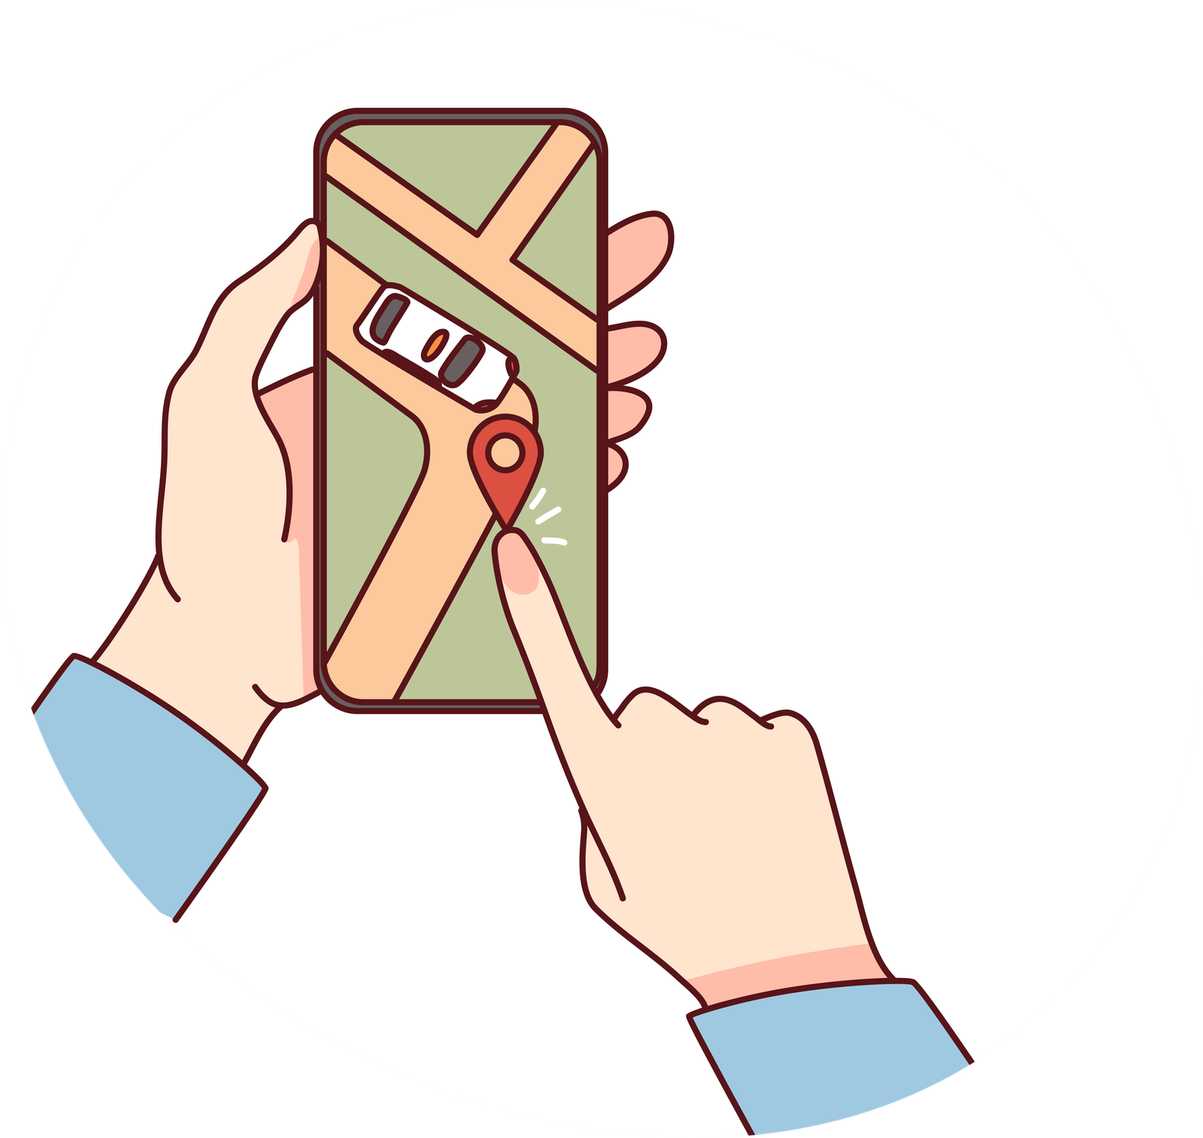
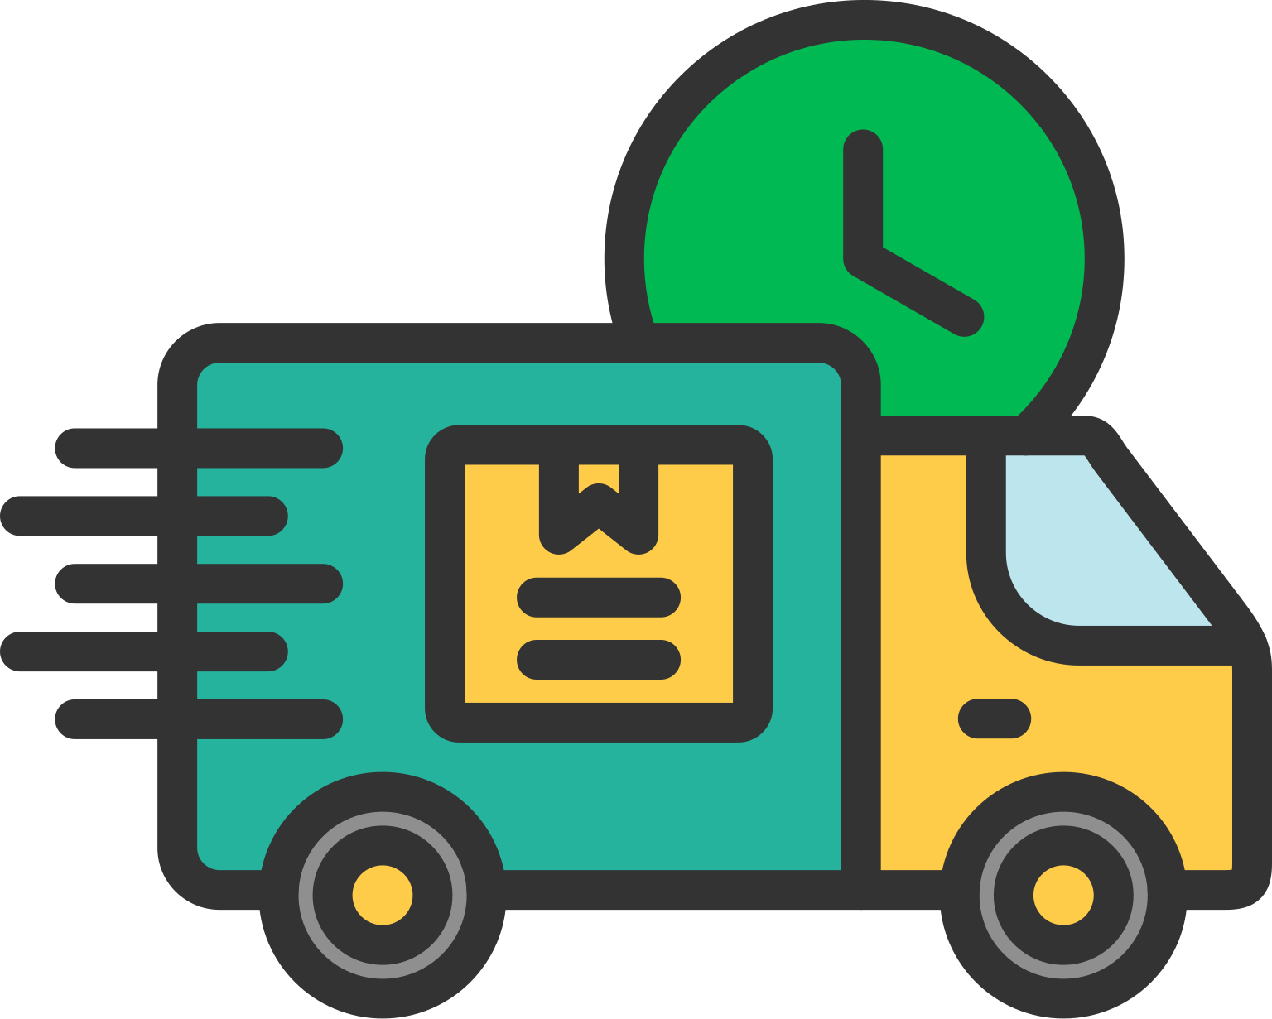
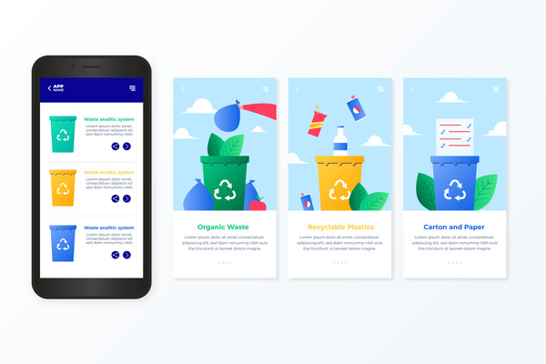




Waste2Wallet
Product and Services
A mobile app for real-time waste collection requests and tracking
Scheduled waste collection service, fixed weekly pick-up times
Instant Naira payment to user wallets, based on weight inside the app.
Mobile airtime rewards are earned via mobile loyalty points which have a cumulative value.
SMS notification system for users who don't always have access to a smartphone.
Notes:
Waste2Wallet has five products and services connected with customer jobs identified in Slide 3. First, a mobile application for requesting waste pickup and tracking collection in real time, addressing the functional need for convenience. Secondly, scheduled waste collection service with fixed weekly collection days, which offers reliability. Third, weight-based instant Naira payment directly to user wallets within the app delivers the financial gain customers seek. Fourth, mobile airtime rewards redeemable through loyalty points, adding a retained incentive. Fifth, an SMS notification system for users without consistent smartphone access, ensuring digital inclusion. Together, these offerings transform waste disposal from a chore into an economically rewarding activity

Slide 7


Waste2Wallet
Pain Reliever
No uncertainty or irregular collection - weekly pickups are fixed
The mobile app's real-time tracking offers complete accountability
Confirmations of pickup and payment status are sent via SMS notification
Instant payment of naira on collection, catering for the lack of financial return
Storage containers provided to help minimise storage odour and pest hazards
Notes:
Waste2Wallet pain relievers are directly addressing each customer’s pain point identified in Slide 4. Fixed weekly pickup schedules eliminate the uncertainty of irregular collection, which Osterwalder et al. (2014) identify as a core pain reliever function. Real-time tracking within the mobile app provides full accountability, a feature currently absent from informal systems. SMS notifications confirm pickup completion and payment status, ensuring transparency. Instant Naira payment upon each collection directly addresses the absence of financial return for recycling. Finally, designated waste containers provided to customers reduce storage odour and pest risks, mitigating health hazards. Collectively, these pain relievers transform waste collection from a frustrating, unreliable service into a predictable, accountable, and rewarding experience

Slide 8






Waste2Wallet
Gain Creators
Weight-based instant naira payout immediately after every weight collection
Loyalty points that can be redeemed for mobile airtime, promoting repeat use
Instant weight measurement of materials shown on the app after each pickup
Monthly recycling reports indicating environmental impact (kg diverted from landfill)
Reward for regular recycling item with a recognition badge inside the app.
Notes:
Gain creators are how Waste2Wallet delivers customer gains. Instant weight-based Naira payment after each collection turns waste into immediate income. Loyalty points redeemable for mobile airtime encourage repeat usage. Transparent weight tracking displayed in the app builds trust through verifiable data. Monthly environmental impact reports showing kilograms diverted from landfill address the emotional gain of contributing to a cleaner community. In-app recognition badges for consistent recycling deliver social recognition. Together, these gain creators transform recycling from an occasional chore into a habit reinforced by financial, informational, and social rewards.

Slide 9

Waste2Wallet
Conclusion
Two Greatest Challenges
Ensuring smooth integration of informal waste collectors without inducing channel conflicts or resistance, since they dominate the waste collection in Lagos and can see the platform as a threat to their livelihoods.
Ensuring regular user involvement in a price-sensitive market where convenience and cost outweigh environmental considerations for decision making
Two Greatest Challenges
Engage in stakeholder dialogue to foster trust and partnerships with informal collectors while avoiding their displacement
Data analytics to track waste diversion metrics and user behaviour, enabling evidence-based decisions for improving retention and participation rates
Notes:
Reflecting on this venture, I have identified two great challenges. First, integrating informal waste collectors without creating channel conflict or resistance. These actors currently hold the monopoly on waste collection in Lagos, and Waste2Wallet could be seen as a threat to their livelihoods. Second, achieving consistent user participation in a price-sensitive market where convenience and cost dominate decision-making over environmental awareness, as confirmed by Ferronato and Torretta (2022). To overcome these challenges, I need to develop two entrepreneurial skills. Negotiation with stakeholders to develop trust and partnerships with informal collectors without replacing them. Data analytics to monitor waste diversion metrics and user behaviours, allowing for informed decisions on enhancing retention and participation. These skills directly impact the conflict and measurement issues in the channel noted in my earlier report.

Slide 10
Waste2Wallet
Reference List
Etim, E. (2024). Bridging the gap: Transforming waste management awareness into action. Cleaner Waste Systems, [online] 9(0), p.100173. https://doi.org/10.1016/j.clwas.2024.100173.
Faiz, F., Le, V. and Masli, E.K. (2024). Determinants of digital technology adoption in innovative SMEs. Journal of Innovation & Knowledge, [online] 9(4), p.100610. https://doi.org/10.1016/j.jik.2024.100610.
Ferronato, N. and Torretta, V. (2022). Waste mismanagement in developing countries: A review of global issues. International Journal of Environmental Research and Public Health, 19(5), p.2790.
Opanuga, J. (2025). Lagos generates 13,000 tonnes of waste daily - Official | The Guardian Nigeria News - Nigeria and World News. [online] The Guardian Nigeria News - Nigeria and World News. Available at: https://guardian.ng/news/nigeria/metro/lagos-generates-13000-tonnes-of-waste-daily-official/.
Osterwalder, A. and Pigneur, Y. (2010). Business Model Generation: A Handbook for Visionaries, Game Changers, and Challengers. Hoboken, New Jersey: John Wiley & Sons.
Osterwalder, A., Pigneur, Y., Bernarda, G. and Smith, A. (2014). Value Proposition Design: How to Create Products and Services Customers Want. Hoboken, New Jersey: John Wiley & Sons.
Roberts-Lombard, M. and Jaiyeoba, O. (2025). Unlocking consumer behaviour: How satisfaction and/or delight, trust and perceived value drive behavioural intentions. South African Journal of Economic and Management Sciences, [online] 28(1), p.17. Available at: https://sajems.org/index.php/sajems/article/view/6160/3578.
Schoeman, D.C. and Rampedi, I.T. (2022). Drivers of Household Recycling Behavior in the City of Johannesburg, South Africa. International Journal of Environmental Research and Public Health, 19(10), p.6229. https://doi.org/10.3390/ijerph19106229.

